Slide 1
School of Engineering
Renewable Energy 1: Solar and Geothermal (EG501J)
Geothermal Energy:
1. General Overview of the Energy Mix
Jeff Gomes
September 2014
jefferson.gomes@abdn.ac.uk

Slide 2
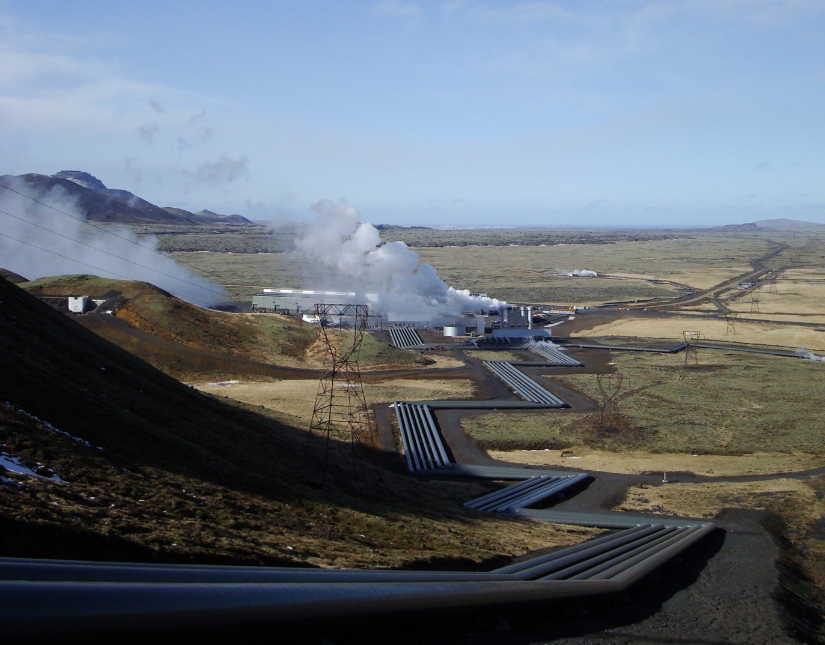
Outline
Energy Consumption
Economics of Geothermal Energy
Basics of a Power Plants
(Hellisheiði Geothermal Power Station)
jefferson.gomes@abdn.ac.uk

Slide 3
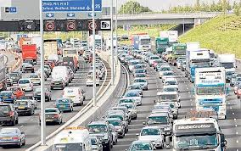
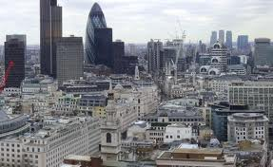


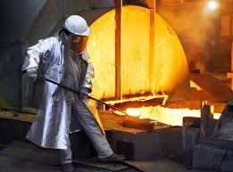

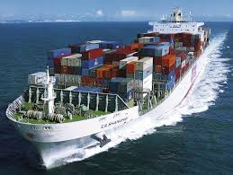
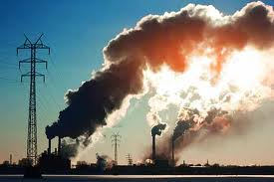
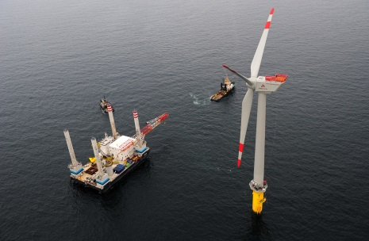
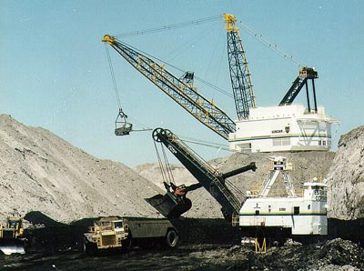
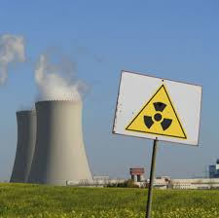

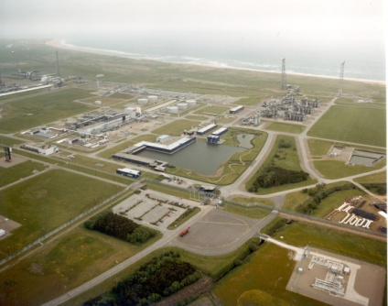
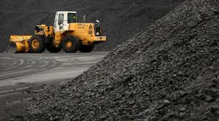

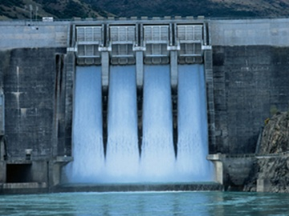
Energy:
Production & Demand
jefferson.gomes@abdn.ac.uk

Slide 4
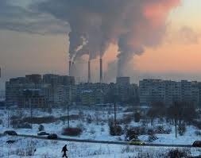
Overview of the Energy Industries
We use energy to provide:
Electricity
Heat
Transport
jefferson.gomes@abdn.ac.uk

Slide 5
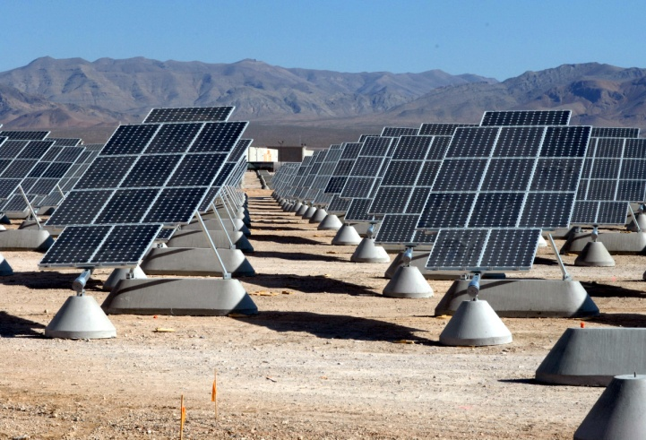
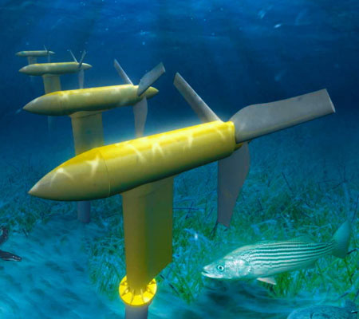
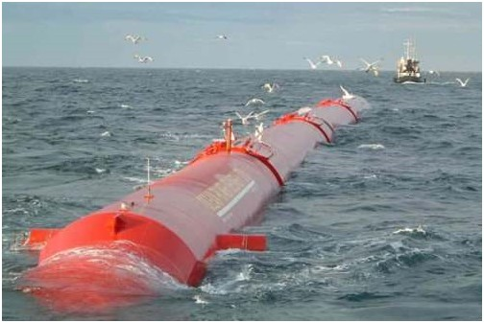
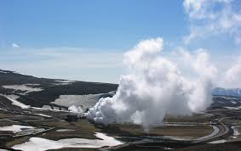
Overview of the Energy Industries
From:
Fossil fuels:
Oil;
Gas;
Coal;
Nuclear;
Hydroelectricity;
Wind;
Solar;
Maritime (wave, tide etc);
Geothermal;
Etc.
jefferson.gomes@abdn.ac.uk

Slide 6

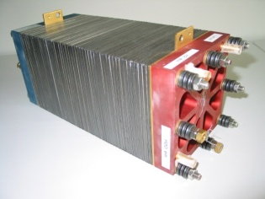
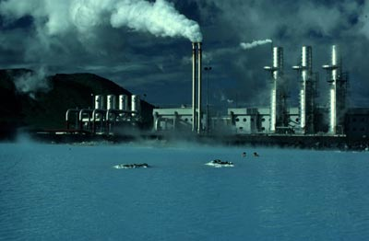
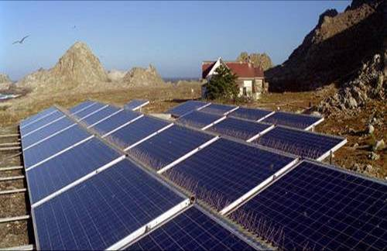
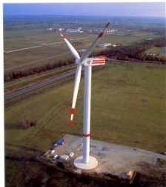
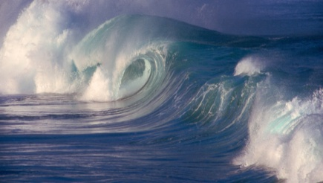
Overview of the Energy Industries
Major Issues:
Rising energy demand;
Need to stabilise atmospheric CO₂ at 550ppm;
Aging fleet of coal & nuclear plant;
Concerns about storage of nuclear waste;
Declining oil & gas reserves 30- 50 years;
Only 70 years of uranium left;
Reduce reliance on hydrocarbons.
Policy drivers:
Low Carbon Society;
Security of Supply;
Fuel Poverty;
jefferson.gomes@abdn.ac.uk

Slide 7
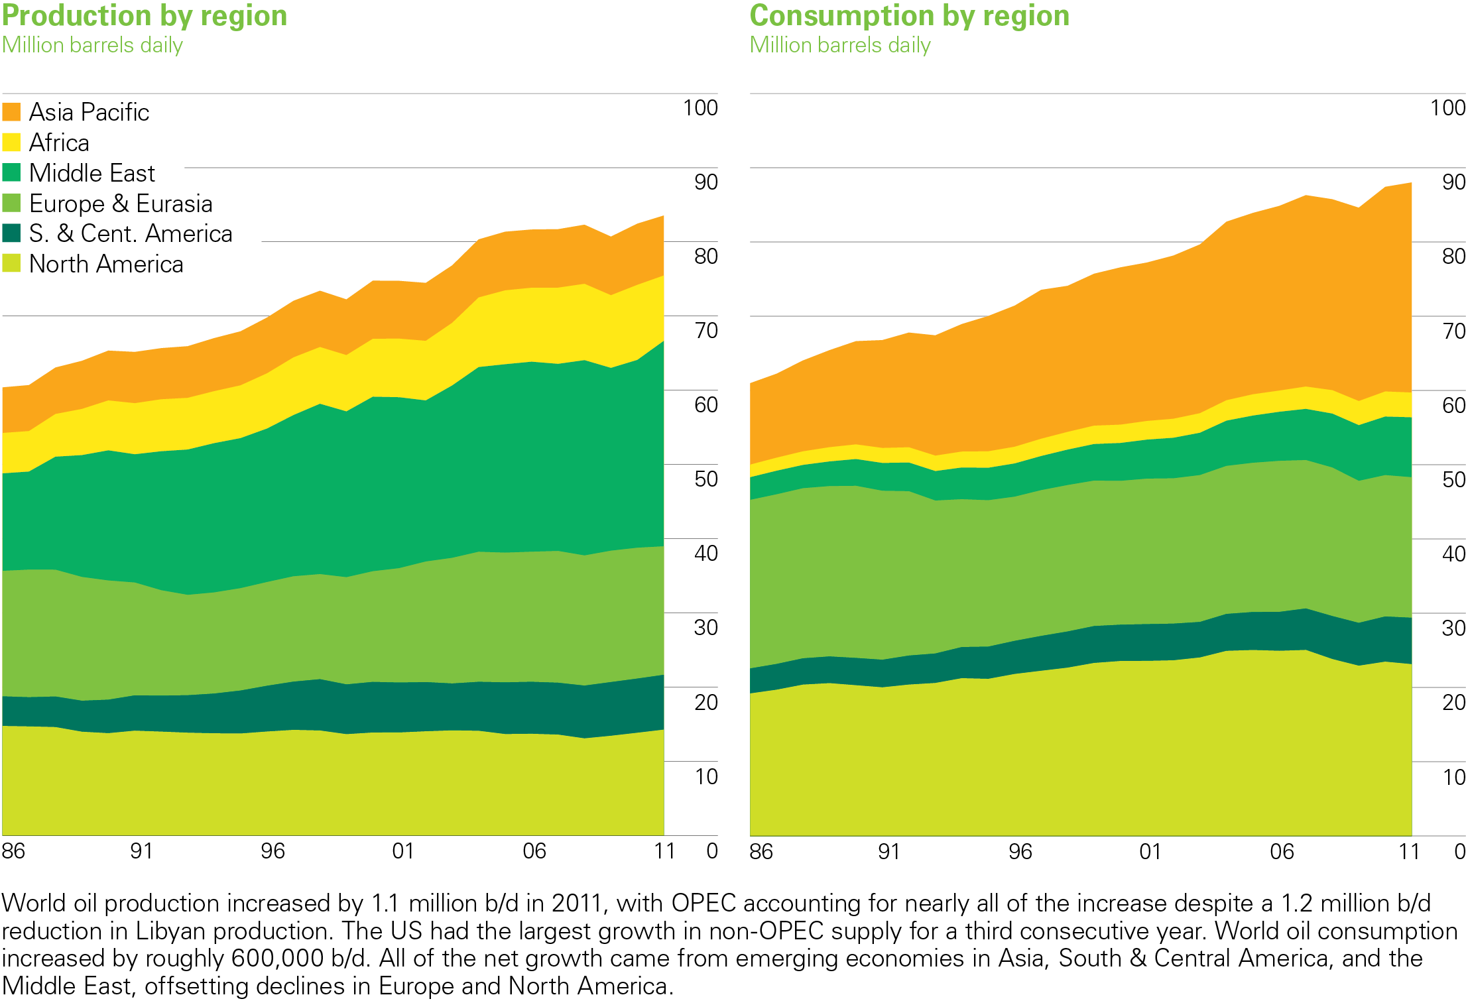
Growth Trends (1985-2010):
Oil Production/Consumption
Source: BP Statistical Review of World Energy (2012)
jefferson.gomes@abdn.ac.uk

Slide 8
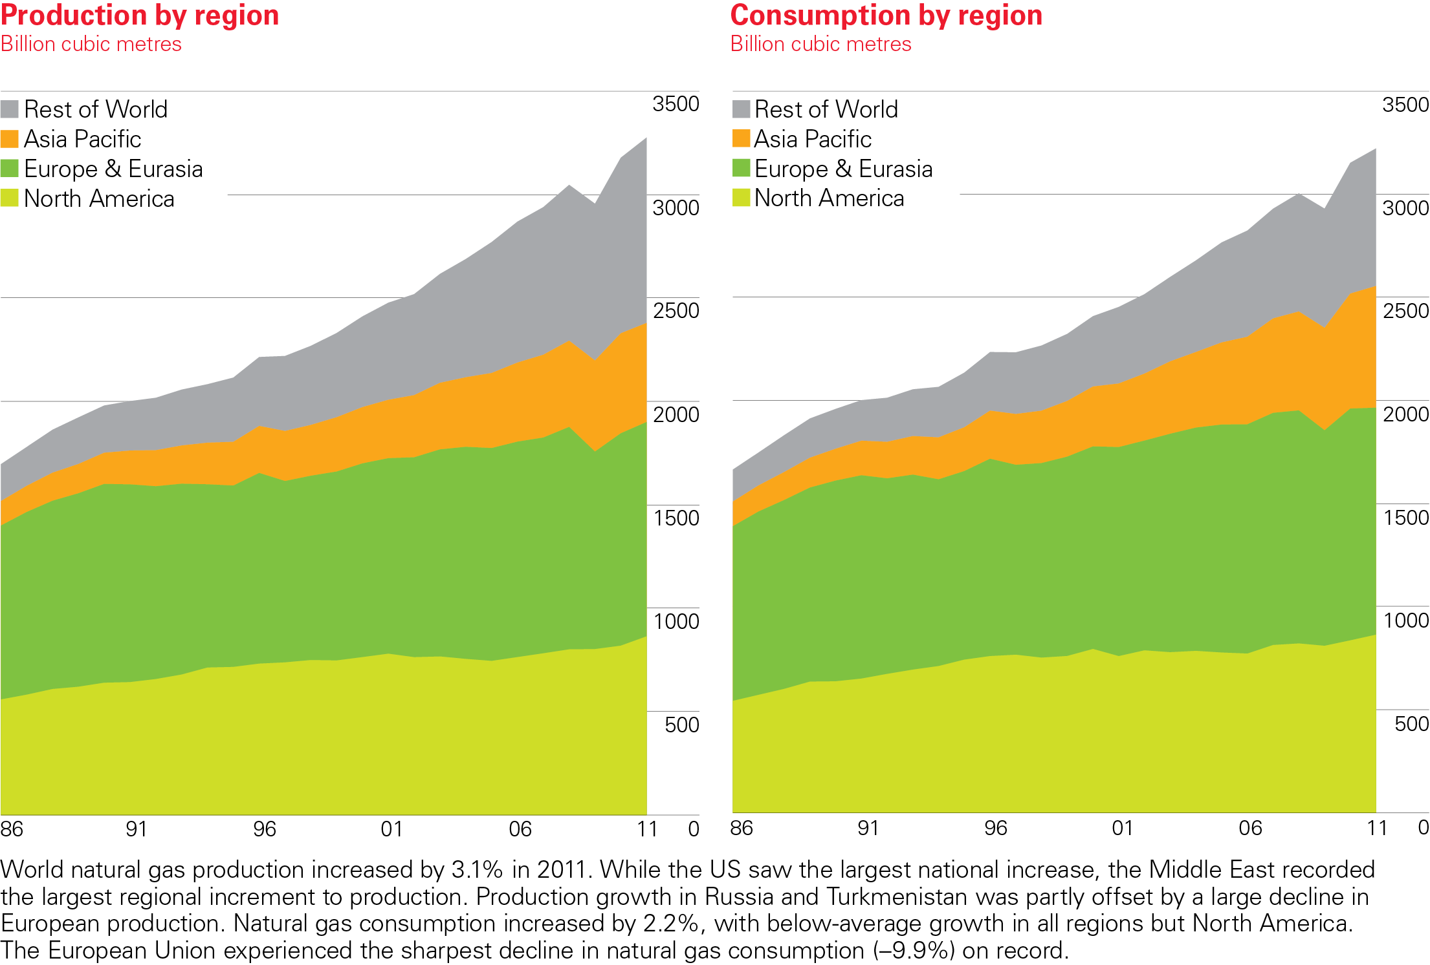
Growth Trends (1985-2010):
Natural Gas Production/Consumption
Source: BP Statistical Review of World Energy (2012)
jefferson.gomes@abdn.ac.uk

Slide 9
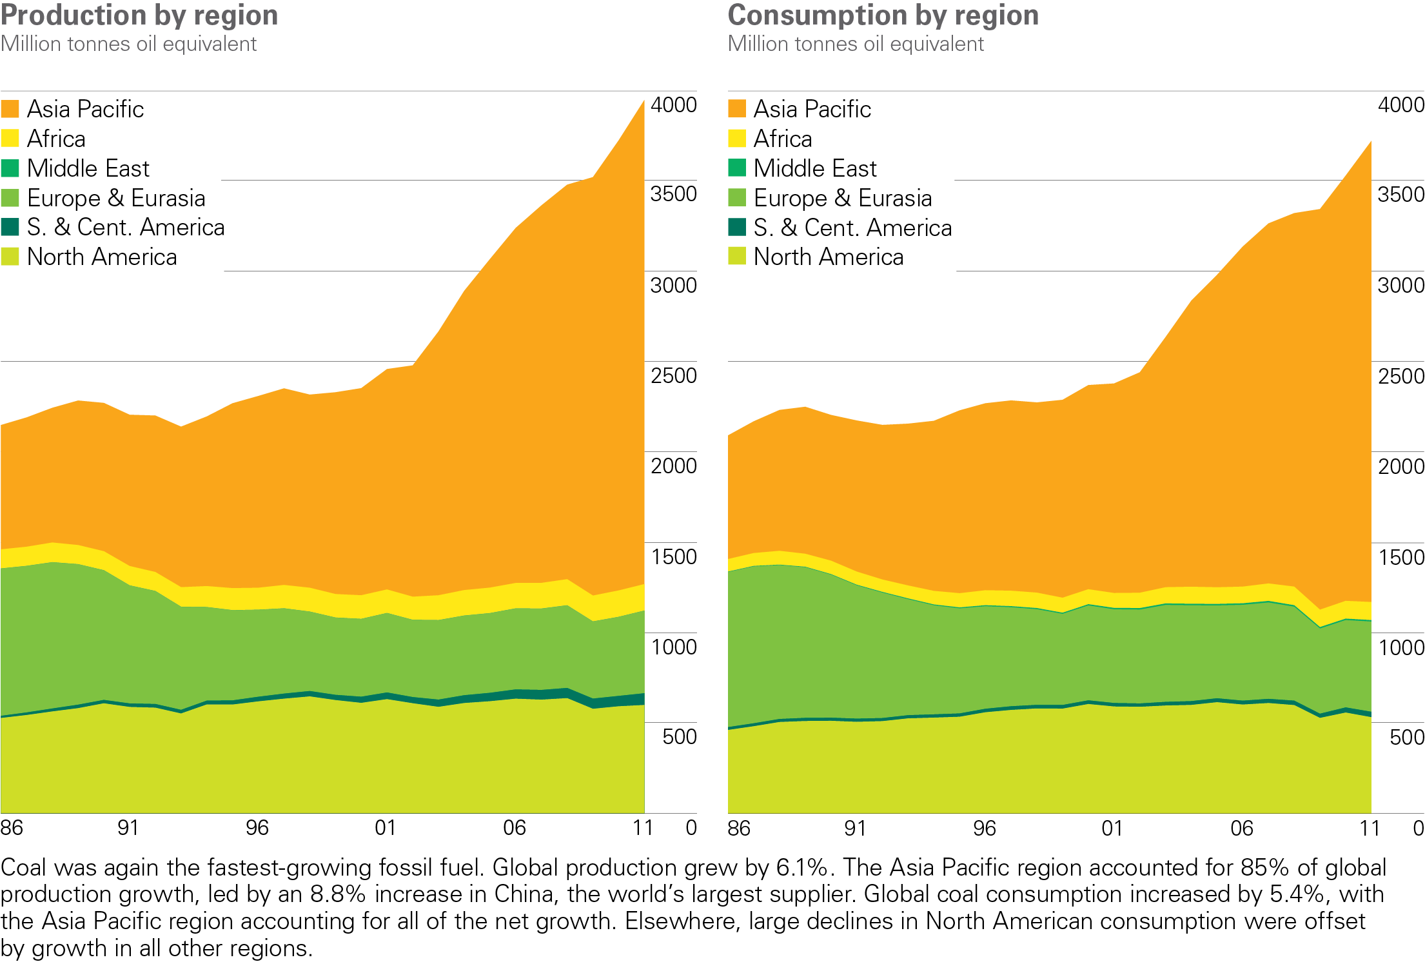
Growth Trends (1985-2010):
Coal Production/Consumption
BP Statistical Review of World Energy 2012
© BP 2012
jefferson.gomes@abdn.ac.uk

Slide 10
Growth Trends (1985-2010):
 | Production 2010 | Historical Growth | Growth(%)
Oil | 86M mbo/day | 1M mbo/year | 1.2
Coal | 3.6B Toe | 160M toe/year | 4.4
Gas | 3150B m³ | 60B m³/year | 1.9
toe: Tonnes oil equivalent
mbo: million barrel of oil
1 toe = 11.63 MWh = 41.87 GJ = 39.7M BTU
1 toe = 7.4 barrel of oil equivalent (boe)
1 barrel of oil = 159 litres
jefferson.gomes@abdn.ac.uk

Slide 11
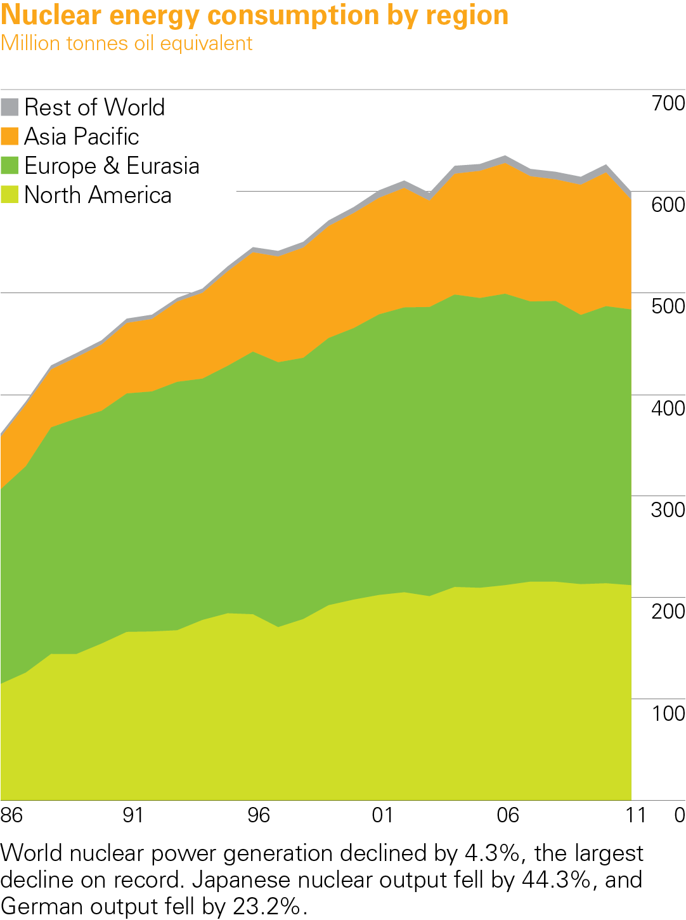
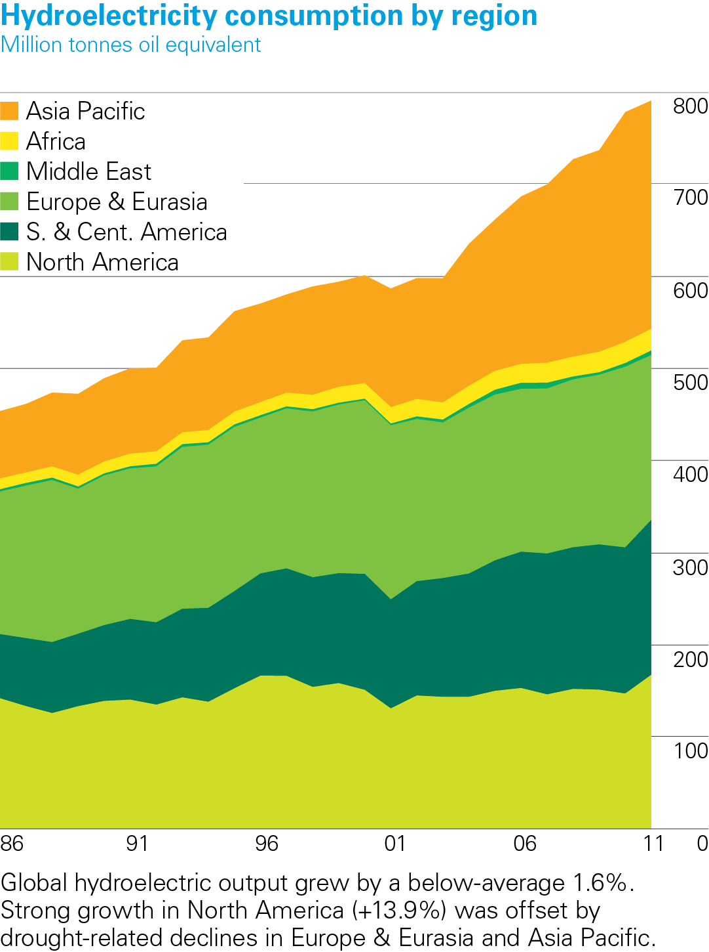
Growth Trends (1985-2010):
Source: BP Statistical Review of World Energy (2012)
jefferson.gomes@abdn.ac.uk

Slide 12
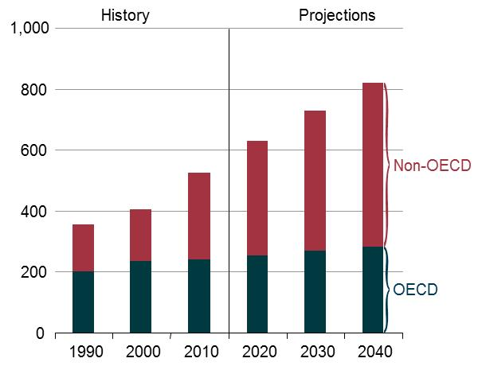
World Energy Consumption (10¹⁵ BTU)
Source: DoE/EIA-0484
jefferson.gomes@abdn.ac.uk

Slide 13
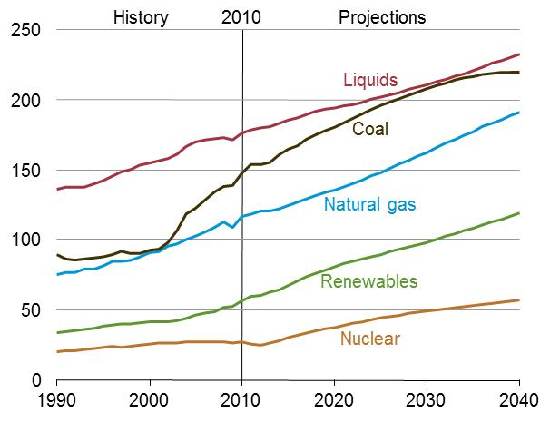
World Energy Consumption (fuel type, 10¹⁵ BTU)
Source: DoE/EIA-0484
Petroleum liquids fuels: crude oil and lease condensate, natural gas plant liquids, bitumen, extra-heavy oil, and refinery gains;
Other liquids fuels: gas-to-liquids, coal-to-liquids, kerogen and biofuels.
jefferson.gomes@abdn.ac.uk

Slide 14
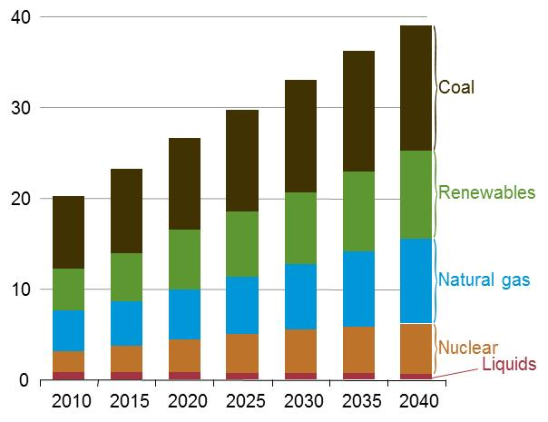
World Net Electricity Generation (fuel type, 10¹² kWh)
Variation (2010-40):
Liquids | -1.0 %
Nuclear | 2.5%
Natural Gas | 2.5%
Renewables | 2.8%
Coal | 1.8%
WORLD | 2.2%
Conversion: 1 kWh = 3412.15 BTU
Source: DoE/EIA-0484
jefferson.gomes@abdn.ac.uk

Slide 15
World Energy
World electricity generation
(10¹² kWh)
Electricity Generation
(Terawatt-hours)
CO₂ Emissions
(Million tonnes)
Source: BP Statistical Review of World Energy (2014)

Slide 16
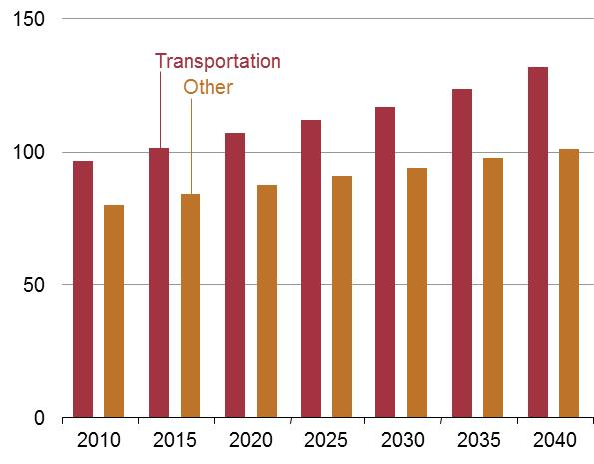
World liquid consumption (10¹⁵ BTU)
Petroleum and other liquid fuels are the main component of energy sector energy;
Transport accounts for 63% of total growth in energy consumption over 2010-40;
Transport Sector (2010-40): +36x10¹⁵ BTU;
Industry Sector (2010-40): +25x10¹⁵ BTU;
Source: DoE/EIA-0484
jefferson.gomes@abdn.ac.uk

Slide 17
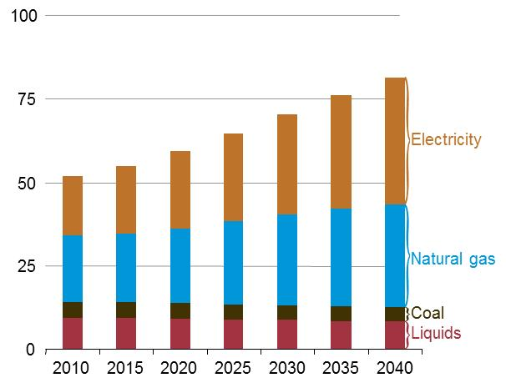
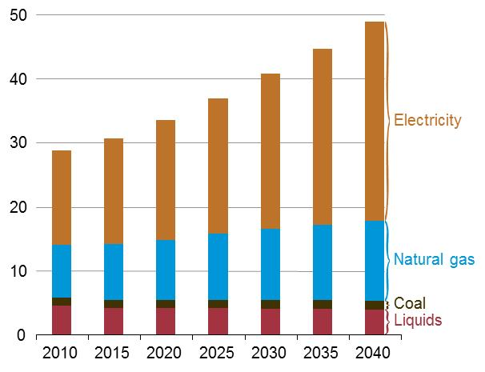
World Residential/Commercial Consumption (10¹⁵ BTU)
Residential
Commercial
Source: DoE/EIA-0484
jefferson.gomes@abdn.ac.uk

Slide 18
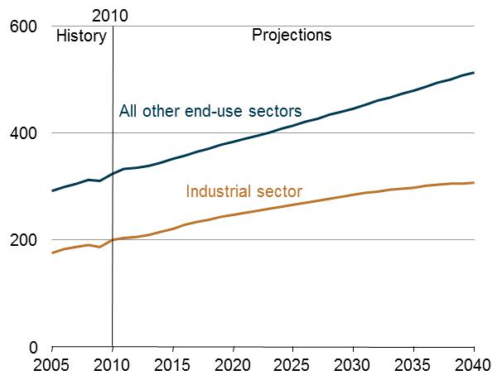
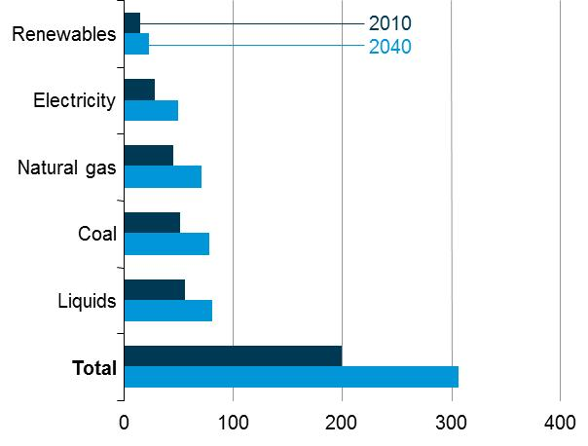
World Industrial Sector Consumption (10¹⁵ BTU)
Source: DoE/EIA-0484
jefferson.gomes@abdn.ac.uk

Slide 19
Energy Consumption: Transport Sector (10¹⁵ BTU)
Region | 2010 | 2015 | 2020 | 2030 | 2040 | Aver. Annual % change
OECD | 57.9 | 56.0 | 55.9 | 54.5 | 55.5 | -0.1
Americas | 32.7 | 32.5 | 32.5 | 31.7 | 32.9 | 0.0
Europe | 18 | 16.3 | 16.2 | 15.7 | 15.7 | -0.5
Asia | 7.1 | 7.2 | 7.1 | 7.0 | 7 | -0.1
Non-OECD | 43.1 | 50.3 | 56.4 | 68.3 | 83.9 | 2.2
Europe and Euroasia | 6.7 | 8.0 | 8.5 | 9.5 | 10.6 | 1.5
Asia | 19.9 | 23.5 | 28.0 | 37.0 | 49.2 | 3.1
Middle-East | 6 | 7.4 | 8.1 | 8.6 | 9.5 | 1.5
Africa | 3.8 | 4.0 | 4.1 | 4.5 | 4.8 | 0.8
Central and South America | 6.6 | 7.3 | 7.7 | 8.8 | 9.8 | 1.3
TOTAL | 101.0 | 106.2 | 112.2 | 122.8 | 139.5 | 1.1
Energy used to move people and goods by road, rail, air, water and pipeline.
Source: DoE/EIA-0484
jefferson.gomes@abdn.ac.uk

Slide 20
Energy Mix in UK
Oil
Gasoline or Diesel
Transport
4%
(with others)
Gas
Heat
(Homes & Business)
37%
Coal
34%
Renewables
5%
Electricity
Nuclear
Power Services
(Homes & Business)
20%
Zero/Low CO₂
High CO₂
jefferson.gomes@abdn.ac.uk

Slide 21
Geothermal Power Capacity (MW)
Cumulative Installed
Nearly 12GW supplied to 24 countries worldwide;
Electricity attends the need of more than 60M people;
Indonesia: 23% of all electricity generated by geothermal sources and;
Iceland: Fully powered by renewables with geothermal producing 17% of the electricity and 87% of the heating;
Source: BP Statistical Review of World Energy (2014)

Slide 22
10 Largest Power Plants of the World (2011)
Rank | Plant | Country | Capacity (MW_{el}) | Aver. Annual Elect. Gen. (TWh) | Plant Type
1 | 3-Gorges Dam | China | 22500 | 98.1 | Hydro
2 | Itaipu Dam | Brazil/Paraguay | 14000 | 98.2 | Hydro
3 | Guri Dam | Venezuela | 10235 | 53.41 | Hydro
4 | Tucurui Dam | Brazil | 8370 | 21.4 | Hydro
5 | Kashiwaazaki-Kariwa NPP | Japan | 8212 | 24.63 | Nuclear
6 | Grand Coulee Dam | USA | 6809 | 21 | Hydro
7 | Longtan Dam | China | 6426 | 18.7 | Hydro
8 | Bruce NPP | Canada | 6272 | 36.25 | Nuclear
9 | Uljin NPP | South Korea | 6157 | 44.81 | Nuclear
10 | Yeonggwang NPP | South Korea | 6139 | 48.16 | Nuclear
Wikipedia
jefferson.gomes@abdn.ac.uk

Slide 23
Largest Power Plants by Energy Source (2011)
Rank | Plant | Country | Capacity (MW_{el}) | Plant Type
1 | 3-Gorges Dam | China | 22500 | Hydro
2 | Kashiwaazaki-Kariwa NPP | Japan | 8212 | Nuclear
3 | Taichung Power Plant | Taiwan | 5780 | Coal
4 | Shoaiba Power Plant | Saudi Arabia | 5600 | Fuel Oil
5 | Surgut-2 Power Plant | Russia | 5597 | Natural Gas
6 | Eesti Power Plant | Estonia | 1615 | Oil Shale
7 | Shatura Power Plant | Russia | 1500 | Peat
8 | Alta Wind Energy Center | USA | 1020 | Wind (onshore)
9 | Tilbury B Power Station | UK | 750 | Biofuel
10 | Hellisheioi Power Station | Iceland | 303 | Geothermal
11 | Sihwa Lake Tidal Power Station | South Korea | 254 | Tidal
12 | Agua Calient Solar Project | USA | 251 | Solar
13 | Agucadora Wave Farm | Portugal | 2 | Marine (wave)
Wikipedia
jefferson.gomes@abdn.ac.uk

Slide 24
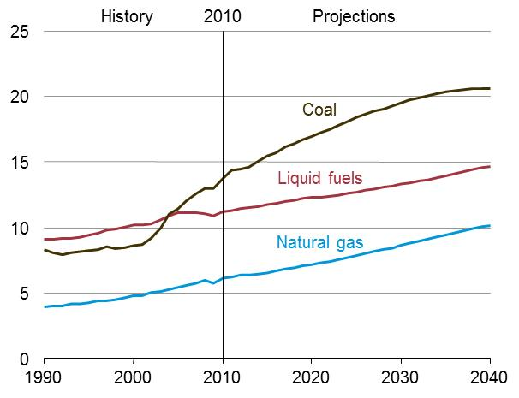
World Energy-related CO₂ Emissions (in billion metric tons)
Source: DoE/EIA-0484
1 cubic ton =40 cubic feet = 1.133 cubic meters
Increase of coal power stations → Increase coal consumption → more GHC (Greenhouse gases);
Growth in consumption of liquid fuels and natural/shale gas over the next 30 years;
Solar, wind, biomass (renewables) will benefit from intensive R&D and will continue to grow, but;
Solar and wind: unlikely to produce more than 25% of world demand of electricity by 2050.
jefferson.gomes@abdn.ac.uk

Slide 25
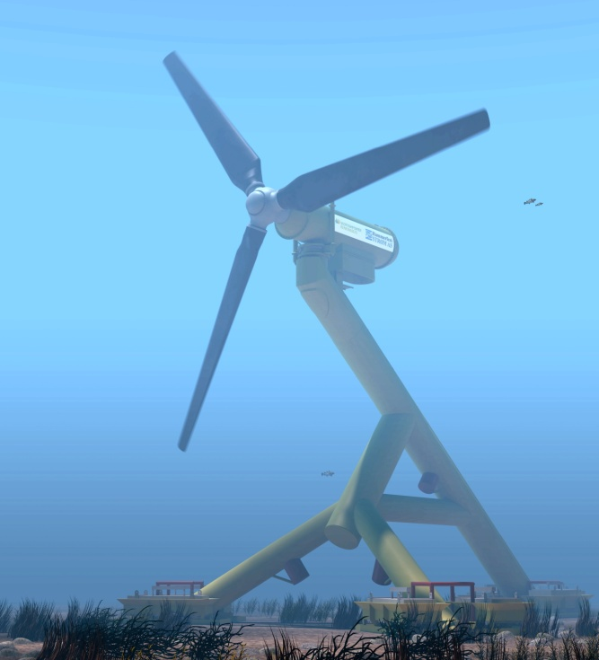
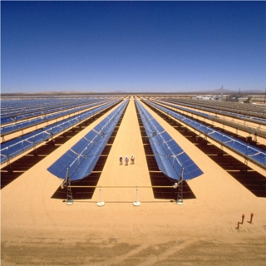
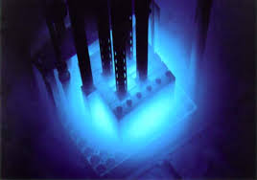

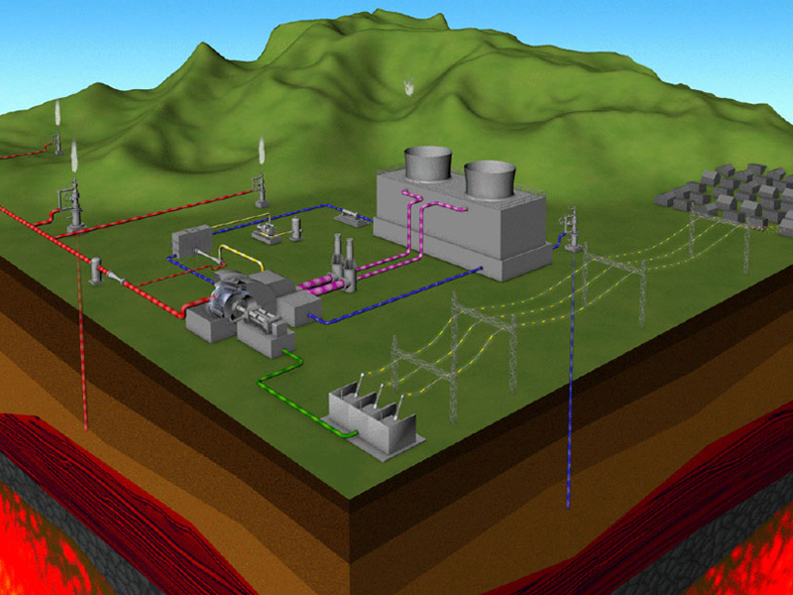
Energy Conversion:
Reapplication of Fundamental Physics
jefferson.gomes@abdn.ac.uk

Slide 26
Why Geothermal (or why pursue a diverse energy matrix)??
To address CLIMATE CHANGE we must:
improve efficiency and;
reduce use of fossil fuel-based energy source.
GHG emissions should be mitigated by the development of new cost-effective technologies:
Carbon Capture Storage and Transportation (CCST);
Nuclear →Management of nuclear waste storage;
Low-carbon energy sources (i.e., renewables);
Integrated Gasification Combined Cycle (IGCC):
Converting carbon-based fuels into syngas (gas-synthesis - mainly H₂, CO);
Combined steam (e.g., Rankine) and gas (e.g., Brayton) cycles using advanced turbines with high thermal efficiency;
Energy security: most countries do not have fossil-fuel resources to sustain their economies.
jefferson.gomes@abdn.ac.uk

Slide 27
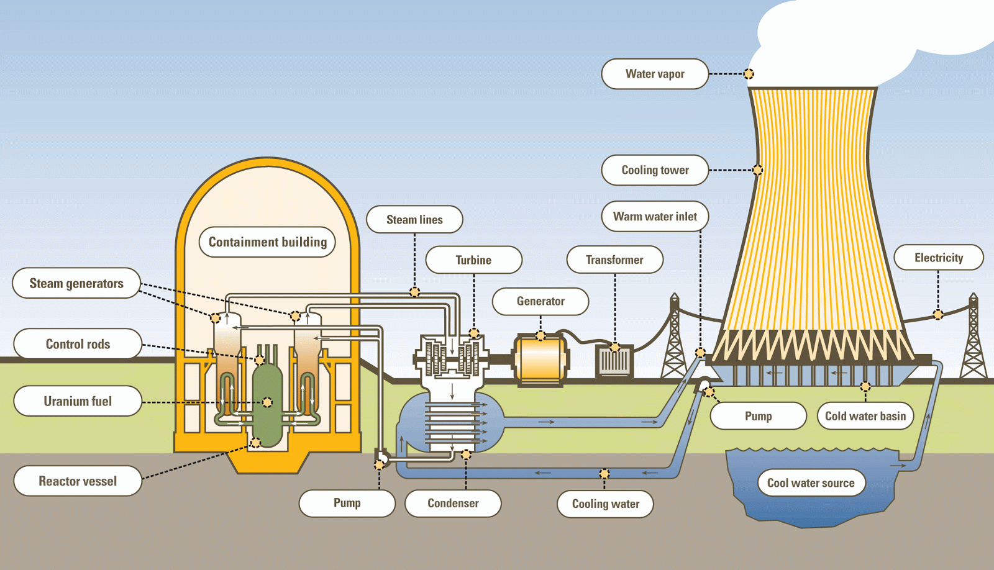
How Power Plants Work? Heat Sources!
Schematics of a Nuclear Power Plant (NPP)
jefferson.gomes@abdn.ac.uk

Slide 28
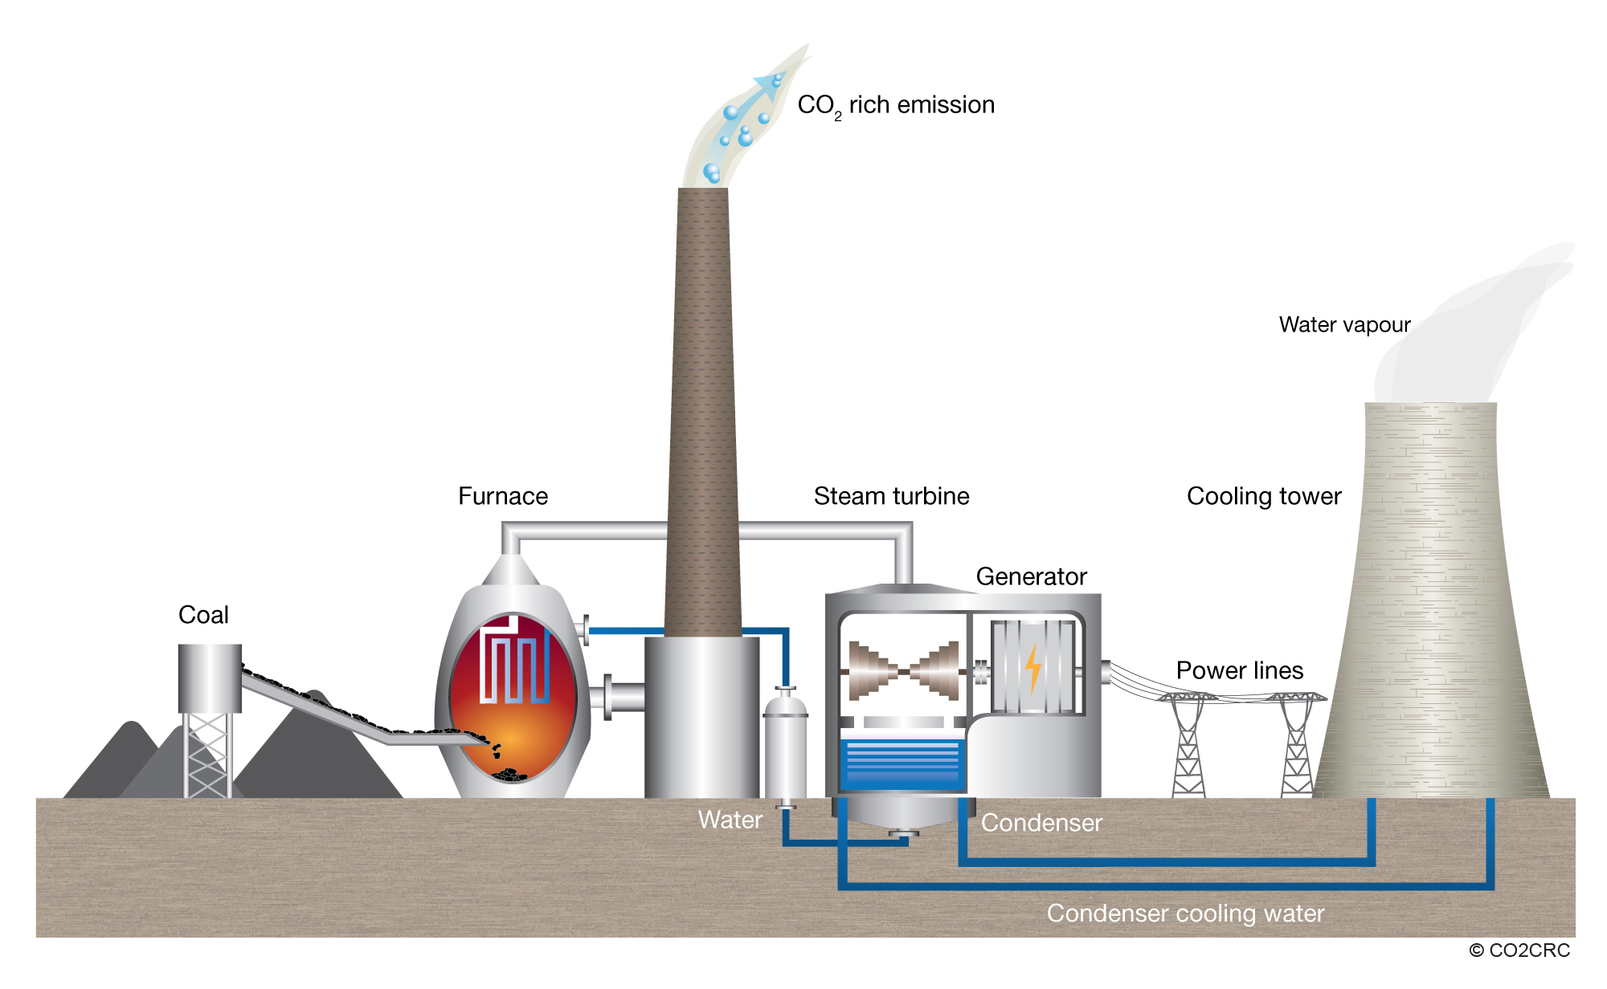
How Power Plants Work? Heat Sources!
Schematics of a Coal-Fired Power Station
jefferson.gomes@abdn.ac.uk

Slide 29
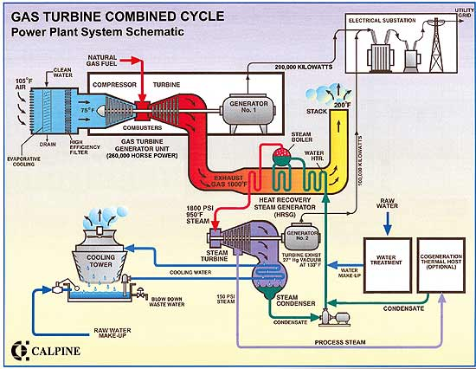
How Power Plants Work? Heat Sources!
Schematics of a Natural Gas Power Station
jefferson.gomes@abdn.ac.uk

Slide 30
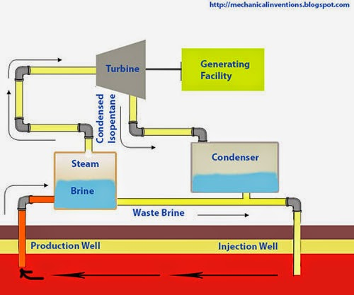
How Power Plants Work? Heat Sources!
Geothermal Power Plant
jefferson.gomes@abdn.ac.uk

Slide 31
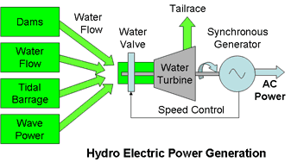
How Power Plants Work? Momentum Sources!
jefferson.gomes@abdn.ac.uk

Slide 32
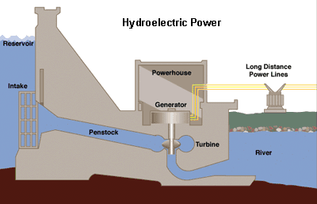
How Power Plants Work? Momentum Sources!
jefferson.gomes@abdn.ac.uk

Slide 33
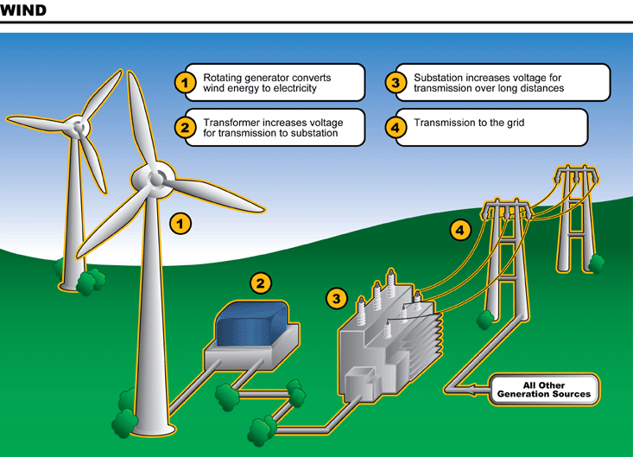
How Power Plants Work? Momentum Sources!
jefferson.gomes@abdn.ac.uk

Slide 34
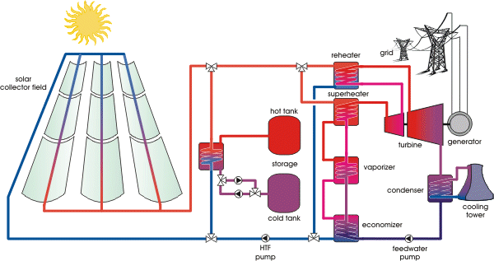
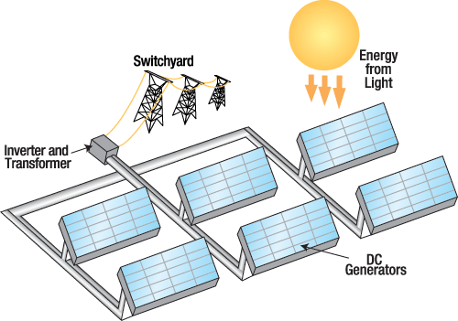
How Power Plants Work? And Solar?
Heat Source: thermal radiation to boil water or;
Photovoltaic (solar cells): direct conversion of the electromagnetic radiation from the Sun to electricity.
jefferson.gomes@abdn.ac.uk

Slide 35
How Power Plants Work?
The vast majority of power plants are based on elements of the following workflow:
Generate heat;
Boil water;
Produced steam is used to turn a (set of) turbine(s);
Turbines are linked with generator to;
Produce electricity.
We saw that:
Fossil fuels and nuclear: 1-5;
Hydro and wind: based on momentum transfer + 4-5;
Geothermal: undergrounded heated water + 2-5;
Solar: (a) solar radiation + 2-5 or,
(b) photovoltaic cells + 5.
jefferson.gomes@abdn.ac.uk

Slide 36
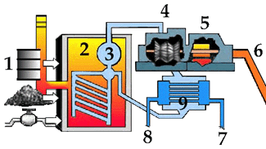
How Power Plants Work? (summary)
Energy Source (coal, oil, NG, nuclear, etc) is ‘burnt’ generating heat in the;
Boiler. Heat is transferred into the water-steam cycle (3-4-9-3);
Steam (at high temperature and pressure) produced by the water vaporisation is driven towards a;
Steam turbine that promotes an isentropic expansion and produces work;
The work is transferred to a generator responsible to produce;
Electricity that is linked to the power grid;
After the expansion (in the turbine), steam (low temperature and pressure) is driven into the condenser (9), where it is transformed in water and returns to the Boiler (2);
System 7-8-9 comprises condenser and cooling waste water.
jefferson.gomes@abdn.ac.uk

Slide 37
How Power Plants Work? (summary)
Energy Source (coal, oil, NG, nuclear, etc) is ‘burnt’ generating heat in the;
Boiler. Heat is transferred into the water-steam cycle (3-4-9-3);
Steam (at high temperature and pressure) produced by the water vaporisation is driven towards a;
Steam turbine that promotes an isentropic expansion and produces work;
The work is transferred to a generator responsible to produce;
System 7-8-9 comprises condenser and cooling waste water.
Electricity that is linked to the power grid;
After the expansion (in the turbine), steam (low temperature and pressure) is driven into the condenser (9), where it is transformed in water and returns to the Boiler (2);
jefferson.gomes@abdn.ac.uk

Slide 38



Power Plants: Turbine Generator
jefferson.gomes@abdn.ac.uk

Slide 39
Energy Consumption
Summary
Multiple energy sources: fossil-fuel, renewables, nuclear, etc;
Demand and production of energy mix;
Thermal and momentum energy sources;
jefferson.gomes@abdn.ac.uk

Slide 40
Energy Consumption
Additional Reading
BP Statistical Review of World Energy 2013: http://www.bp.com/content/dam/bp/pdf/statistical-review/statistical_review_of_world_energy_2013.pdf
Annual Energy Outlook 2014 with Projections to 2014 (DoE/EIA-0383): http://www.eia.gov/forecasts/aeo/pdf/0383(2014).pdf
Annual Energy review 2011 (DoE/EIA-0384): http://www.eia.gov/totalenergy/data/annual/pdf/aer.pdf
Energy for a Sustainable Future: Reports and Recommendations (2010), The Secretary-General’s Advisory Group on Energy and Climate Change (AGECC): http://www.un.org/wcm/webdav/site/climatechange/shared/Documents/AGECC%20summary%20report%5B1%5D.pdf
The Future of Geothermal Energy: https://www1.eere.energy.gov/geothermal/pdfs/future_geo_energy.pdf
R. DiPippo (2012) ‘Geothermal Power Plants’; Butterworth Heinemann.
jefferson.gomes@abdn.ac.uk

